Slide 1


Department Of Electronics & Communication Engineering
M.Kumarasamy College of Engineering, Karur.
OB-SU PORTAL

Slide 2
Gonna be presented by…
Arshidha U
Harseela S
Haasnie S
Aishwarya R

Slide 3
OBSU PORTAL
The OBSU stands for:
OB - Objective
SU – Subjective
An Examination portal.

Slide 4
Agenda
Problem Statement
Objectives
Existing System
Proposed System
Modules Identified
Work Flow
Conclusion
Results

Slide 5
ABSTRACT
The online quiz portal aims to provide an engaging and interactive platform for student assessment and expression across diverse subjects. It administers both objective and subjective questions, employing advanced AI algorithms such as BERT and BM25 to evaluate students' subjective responses. These algorithms analyze semantic similarity and relevance when comparing student answers to tutor-provided answer keys, resulting in fair and accurate scores. Furthermore, the portal doesn't stop at grading; it offers students valuable feedback and suggestions to enhance their comprehension of subjects. The user interface is designed for easy access and navigation, allowing students to submit answers effortlessly. Various question formats, including multiple-choice, fill-in-the-blank, short answer, and essay questions, cater to different learning objectives. The portal provides comprehensive support to students, including hints, detailed explanations, and illustrative examples, fostering deeper subject understanding. Educators benefit from performance reports, item analysis, and difficulty analysis, aiding in tailored teaching approaches. To maintain academic integrity, the portal incorporates robust security measures. These include time limits, randomized question order, and proctoring tools to deter unauthorized behavior, ensuring a fair assessment environment.

Slide 6
Introduction
This portal is concentrated in the development of the Modern Quiz application to engage the users who attending the quiz in a legacy/protracted mode.
Developing with the MERN Stack.
ANTD UI is been used*.

Slide 7
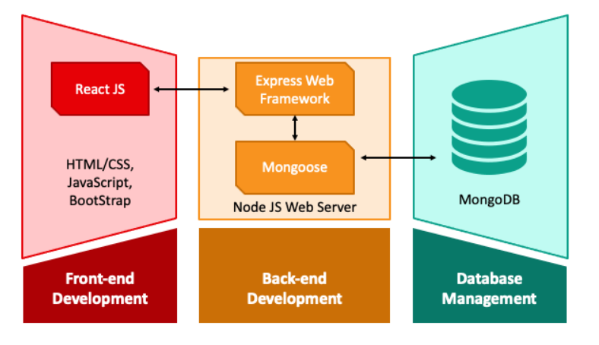
The Architecture
A 3 tier Architecture.

Slide 8
What’s the problem ?
Lack of efficient and non user-friendly quiz portal for education.
The need for modernizing the quiz experience.

Slide 9
OBJECTIVES
Create an advanced quiz portal for students and educators.
Enhance the learning and assessment process.

Slide 10
Why Not Existing ?
Limited functionality.
Outdated user interface.
Inefficient quiz management.

Slide 11
Why New & What’s New ?
This Portal is going to be developed in MERN Stack.
Concentrated on UI & UX.
Feature rich quiz application.
Streamlined quiz creation and management.

Slide 12
MODULES
User Authentication
01
Quiz Administration
02
Quiz Taking
03
Results Analysis
04
Admin Dashboard
05

Slide 13
Flow..!
Phase 1
System Design (MERN Setup)
Phase 2
Development
Phase 3
Testing and Refinement
Phase 4
Deployment on WEB– Optional Feature

Slide 14
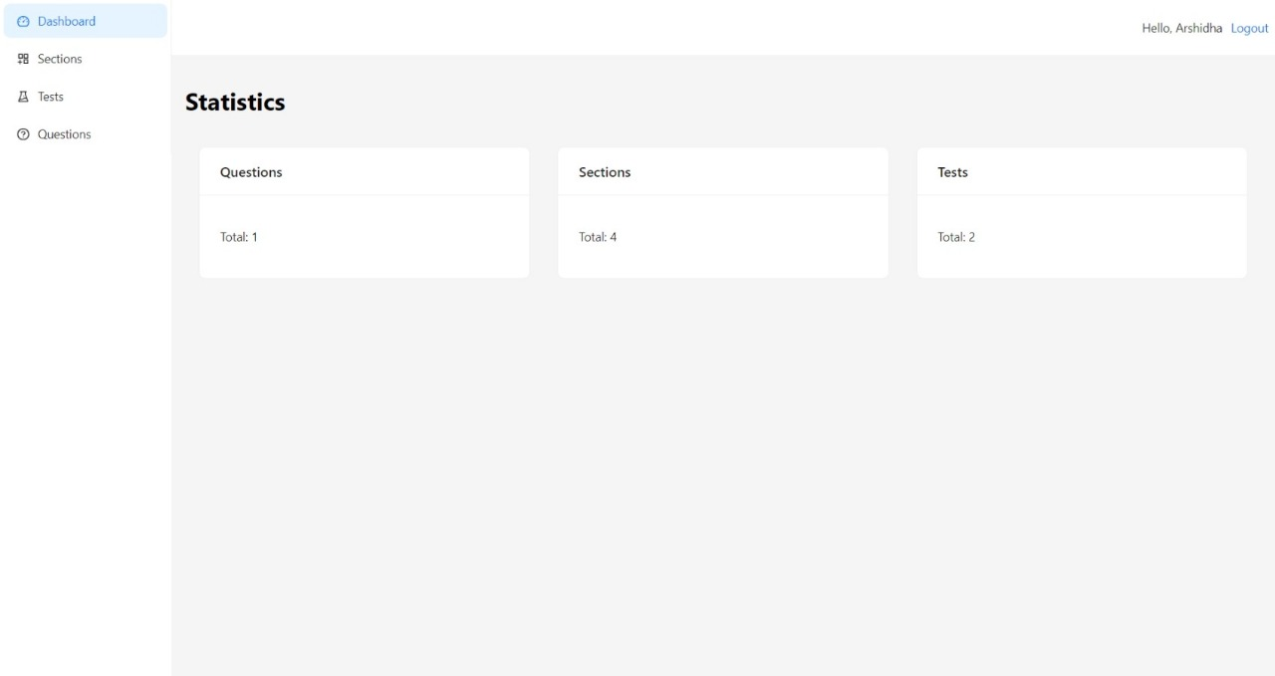
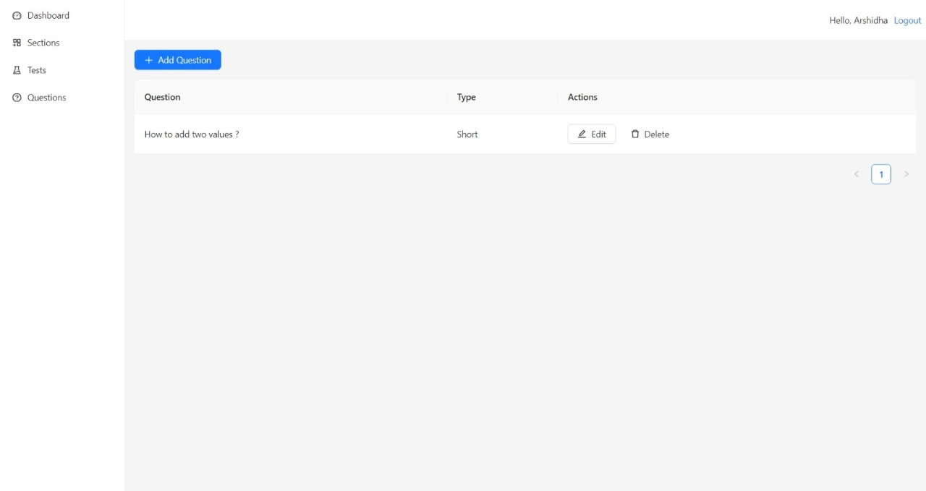

RESULT

Slide 15

Let’s conclude…!
The OBSU PORTAL quiz application is a significant step forward in modernizing education.
It offers a user-friendly experience and efficient quiz management.
We are excited about its potential impact on education.

Slide 16
Thank you

